Slide 1

A class-based styling approach for Real-time Domain Adaptation in Semantic Segmentation
Gabriele Rosi s291082 – Matteo Merlo s287576 – Andrea Tampellini s288266

Slide 2
Introduction
1

Slide 3
Why domain adaptation? (1)
Semantic segmentation is one of the most popular topic in last years. But to train a model, labelled datasets are required and for real-world datasets this operation can be very expensive (in term of time required).
In such situation synthetic datasets became protagonist since the label are automatically generated by the computer.
One can argue that it’s possible to train a model on a source domain with labels (e.g. a synthetic dataset) and apply it to an unlabelled target domain (e.g. real-world dataset).
But this is not possible!

Slide 4
Why domain adaptation? (2)
Domain shift is a phenomenon that happens when the distribution of source data (on which the algorithm has been trained) is different from target data (on which the algorithm is applied).
Some examples are appearance changes due to illumination conditions, appearance changes due to seasonal and time changes, changes due to different sensors or use of synthetic data.
To resolve this issue, several domain adaptation algorithms have been proposed in order to reduce the gap between the source and the target data.

Slide 5
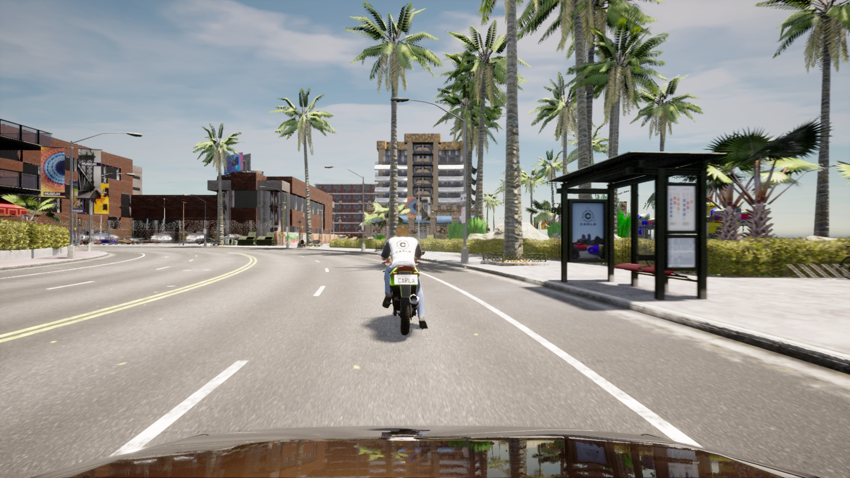
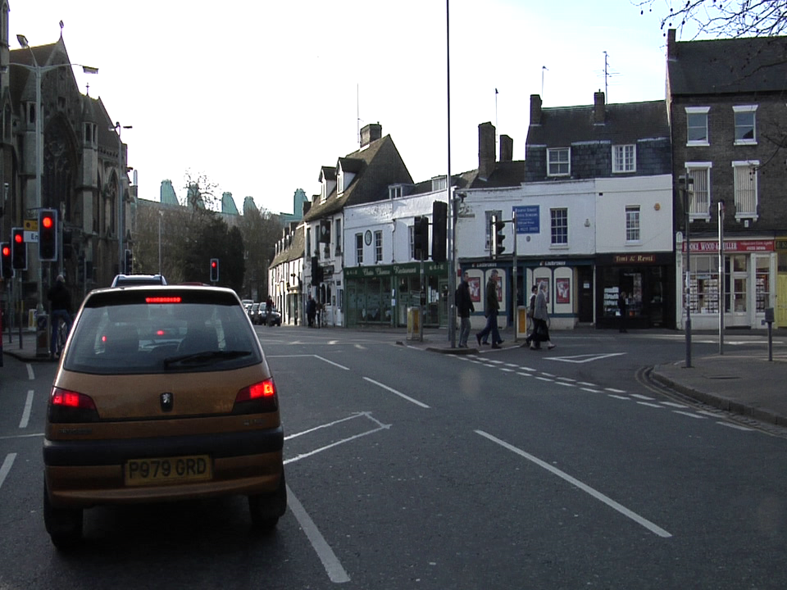
Dataset used
The datasets used in this work are:
(a part of) the IDDA dataset [1], that is composed by synthetic images
the CamVid dataset [2], that is composed by real-world images captured in UK
IDDA image example
CamVid image example
[1] E. Alberti, A. Tavera, C. Masone, and B. Caputo, “Idda: a large-scale multi-domain dataset for autonomous driving,” 2020.
[2] G. J. Brostow, J. Fauqueur, and R. Cipolla, “Semantic object classes in video: A high-definition ground truth database,” Pattern Recognition Letters, 2008.

Slide 6
Our work (1)
Our work consists of performing a domain adaptation task from IDDA to CamVid in a real-time semantic segmentation setting.
To accomplish such task, we adopt a Domain-Adversarial Training approach. In this kind of technique there are two main actors: a segmentation network G and a discriminator network D.
G tries to predict the semantic map for the input images
D tries to predict which domain (source or target) the semantic maps belongs to.
An adversarial loss is calculated on the target prediction and the network propagates gradients from D to G.
In this way G is encouraged to generate similar distribution both for source and target domain

Slide 7
Our work (2)
To improve the performance of the domain-adversarial training described before, we introduce a Style Transfer Algorithm whose aim is to “transfer” a specific style to the source images.
We perform alternative stylization using both target images and random texture images to test the robustness of our method.
The results that we achieved demonstrate that our work can improve in some way the vanilla domain-adversarial training algorithm.

Slide 8
Proposed Method
2

Slide 9
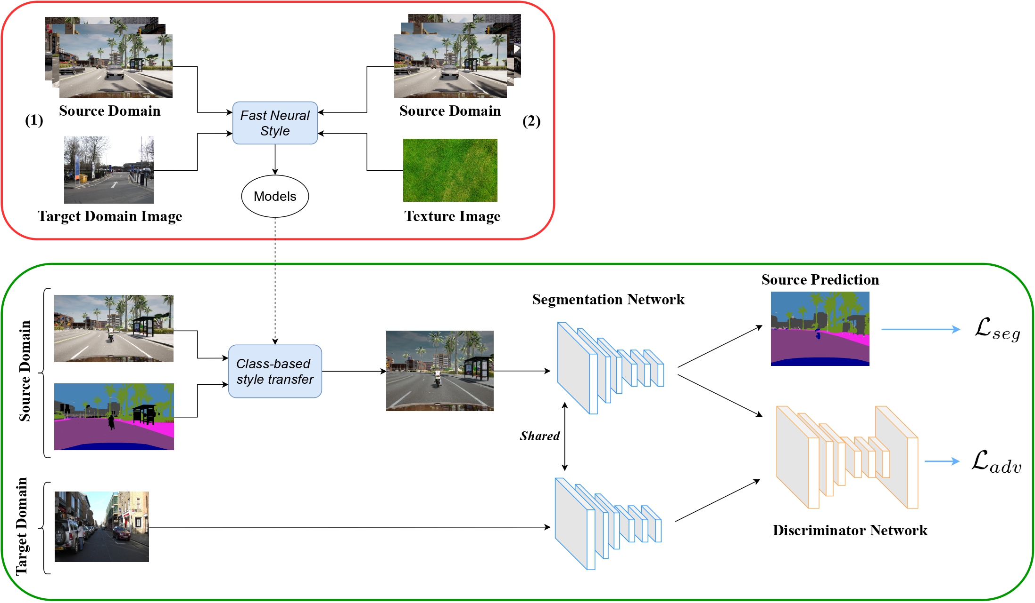
Our network (overview)

Slide 10
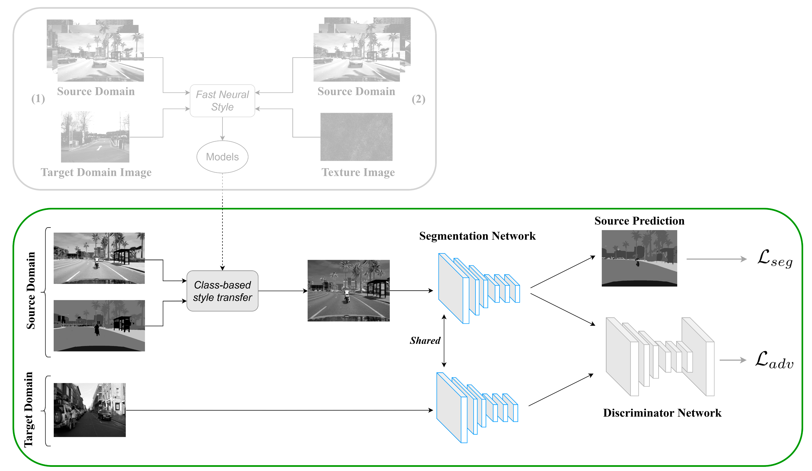
Our network (segmentation network)
Segmentation Network: BiSeNet
Containing two parts:
spatial path
context path

Slide 11
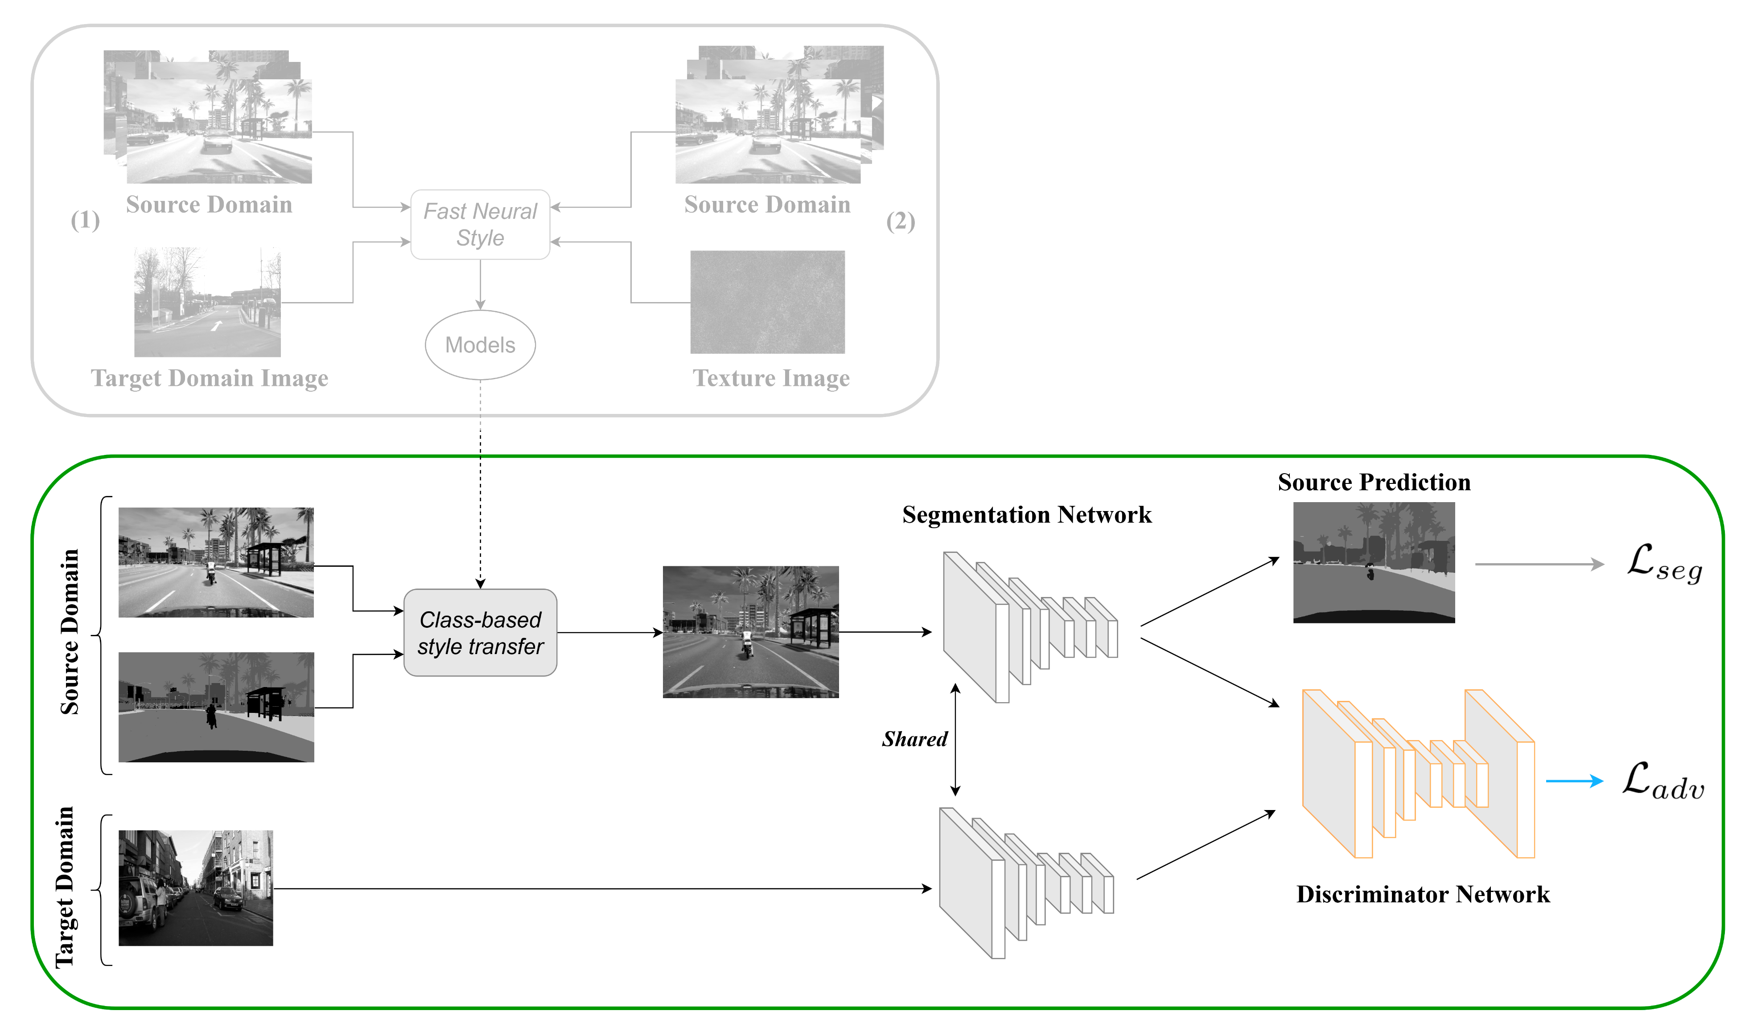
Our network (discriminator network)
Discriminator
Fully Convolutional network → judge if the image come from target or source

Slide 12
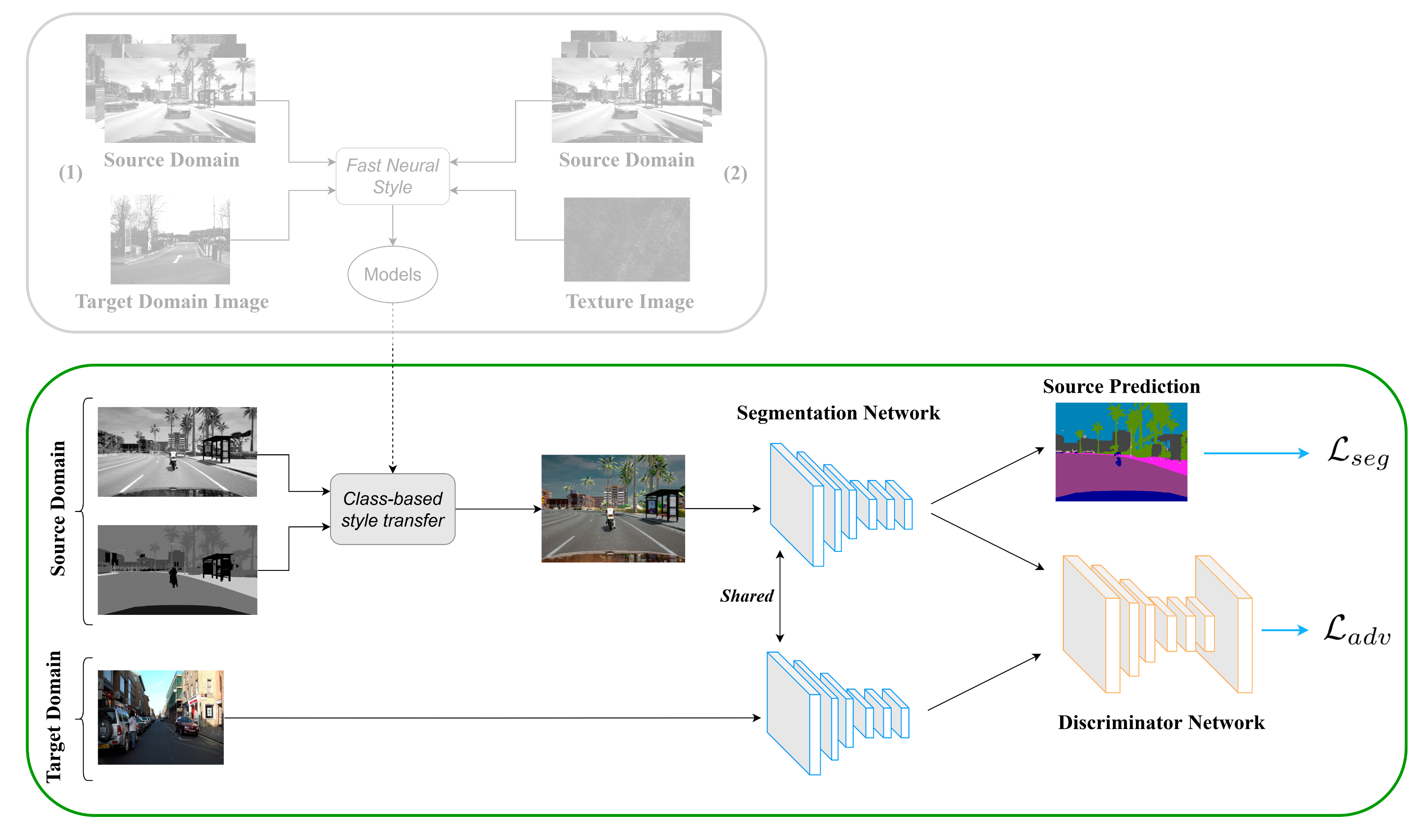
Our network (losses)
Losses
Loss segmentation → Dice or Crossentropy
Loss adversarial → To make the distribution of the target prediction closer to the source one

Slide 13
Proposed project extension
Inspired by the stylization technique used:
Class-based styling: Real-time localized style transfer with semantic segmentation [3]
Learning texture invariant representation for domain adaptation of semantic segmentation [4]
In CBS paper images are stylized in real-time.
Goal: diversify the textures and improve the final performances
[3] L. Kurzman, D. Vazquez, and I. Laradji, “Class-based styling: Real-time localized style transfer with semantic segmentation,” 2019.
[4] M. Kim and H. Byun, “Learning texture invariant representation for domain adaptation of semantic segmentation,” 2020.

Slide 14
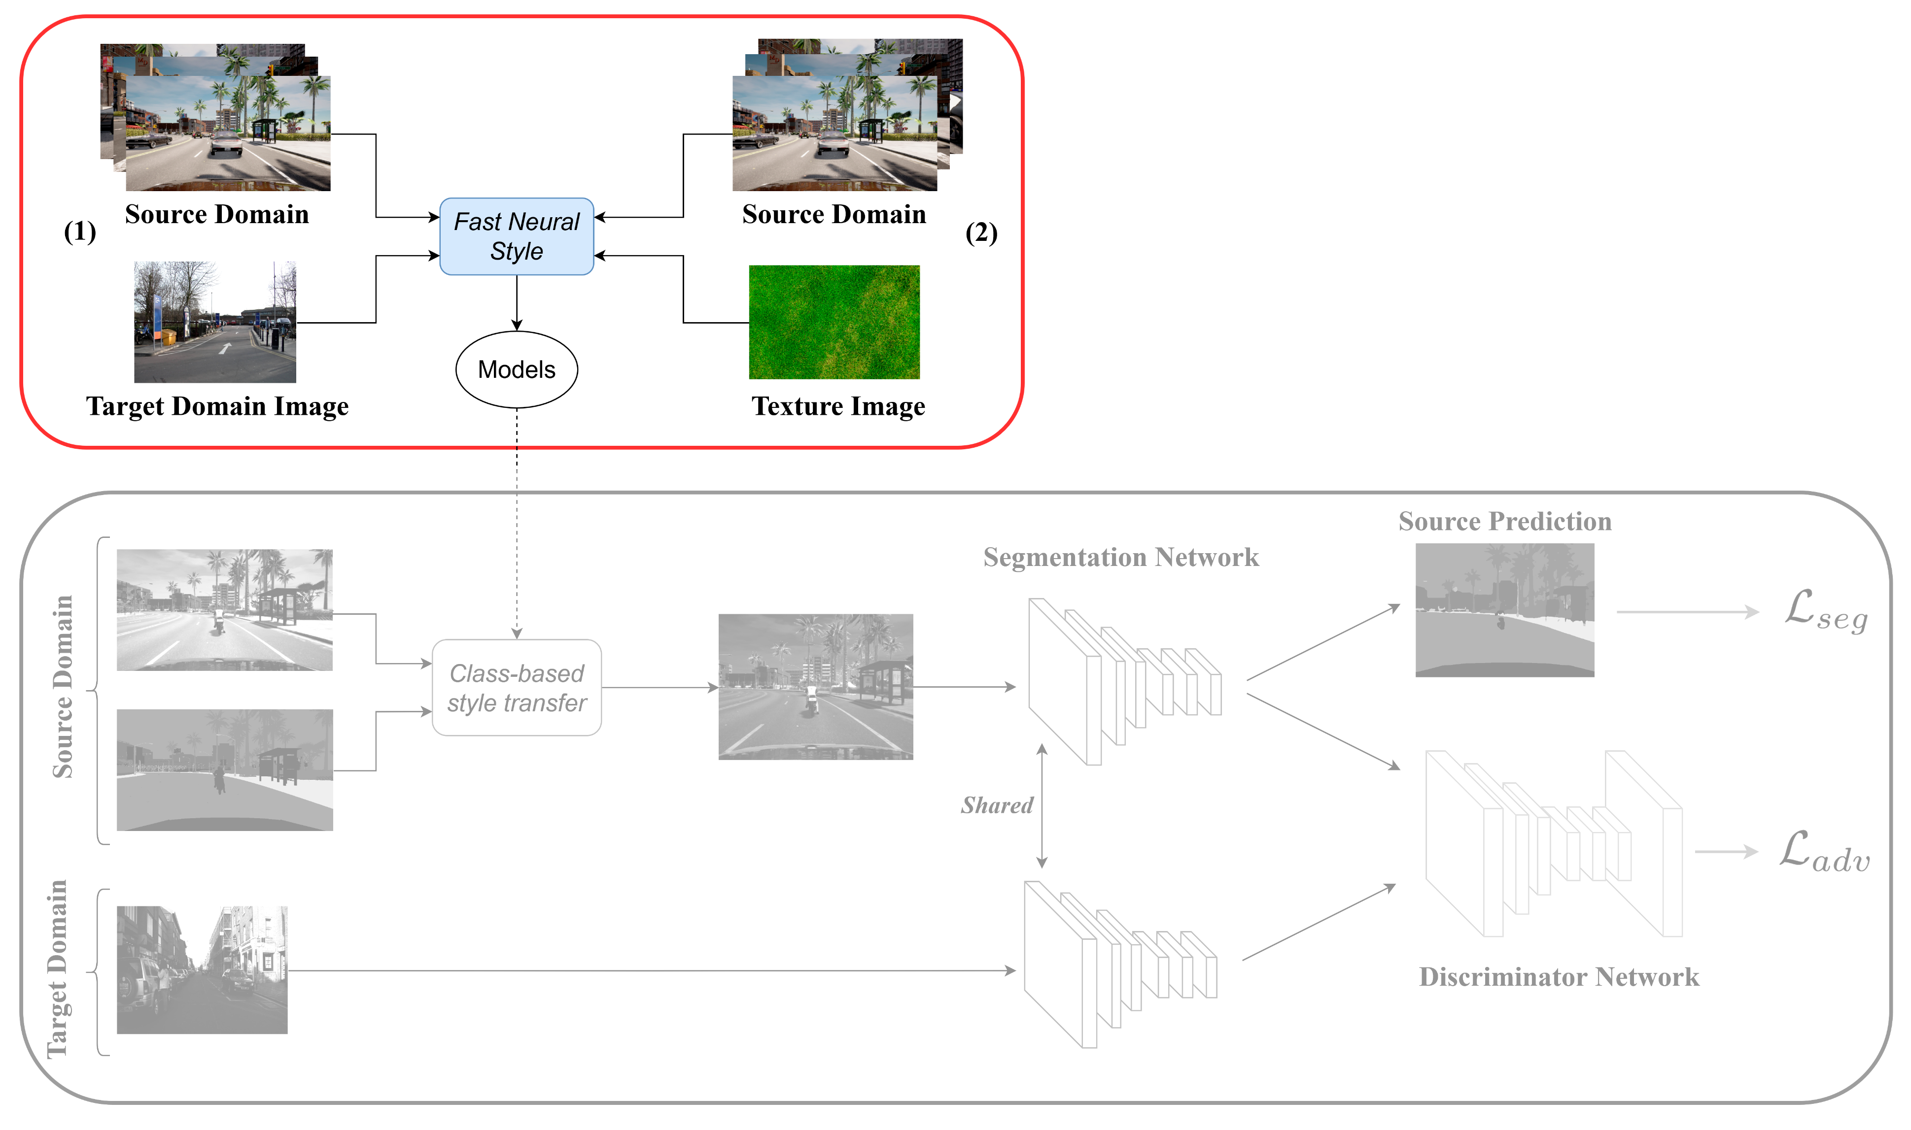
Our network (style models creation)
The network used is from fast neural style [5]
We train the model on the entire length of source dataset
Then some selected CamVid and texture images are used as style images.
[5] J. Johnson, A. Alahi, and L. Fei-Fei, “Perceptual losses for real-time style transfer and super-resolution,” 2016.

Slide 15
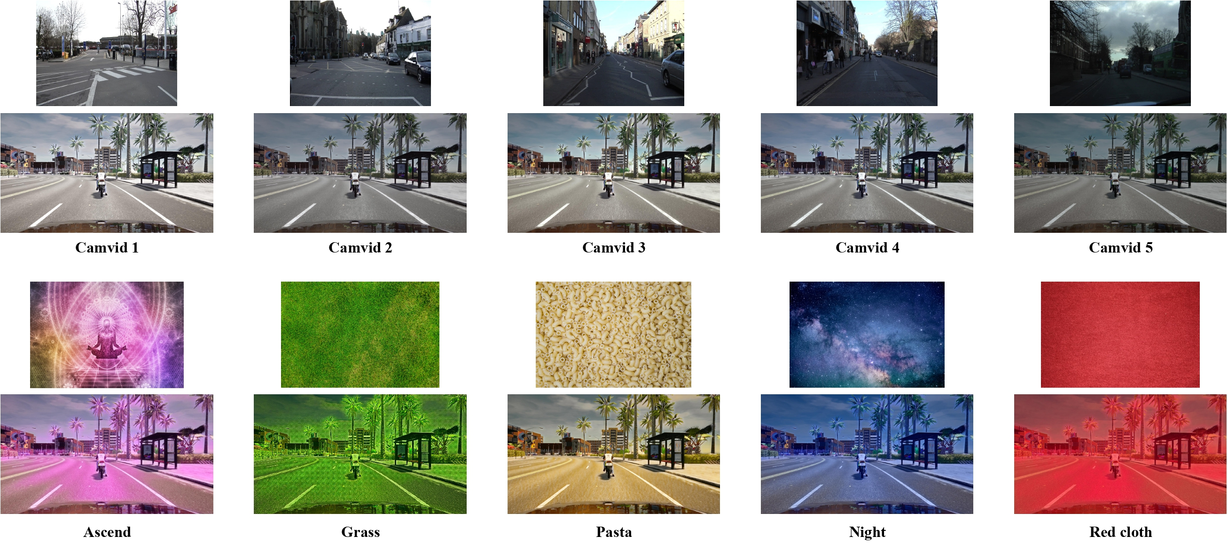
Style models created

Slide 16
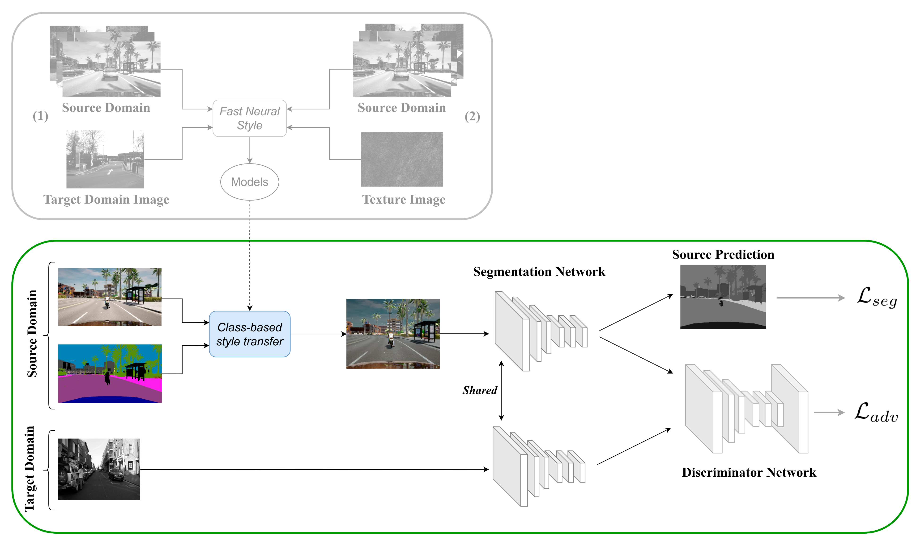
Our network (class-based style)
CBS stylizes some classes of source images as content images.
Each class is stylized with a probability p.

Slide 17
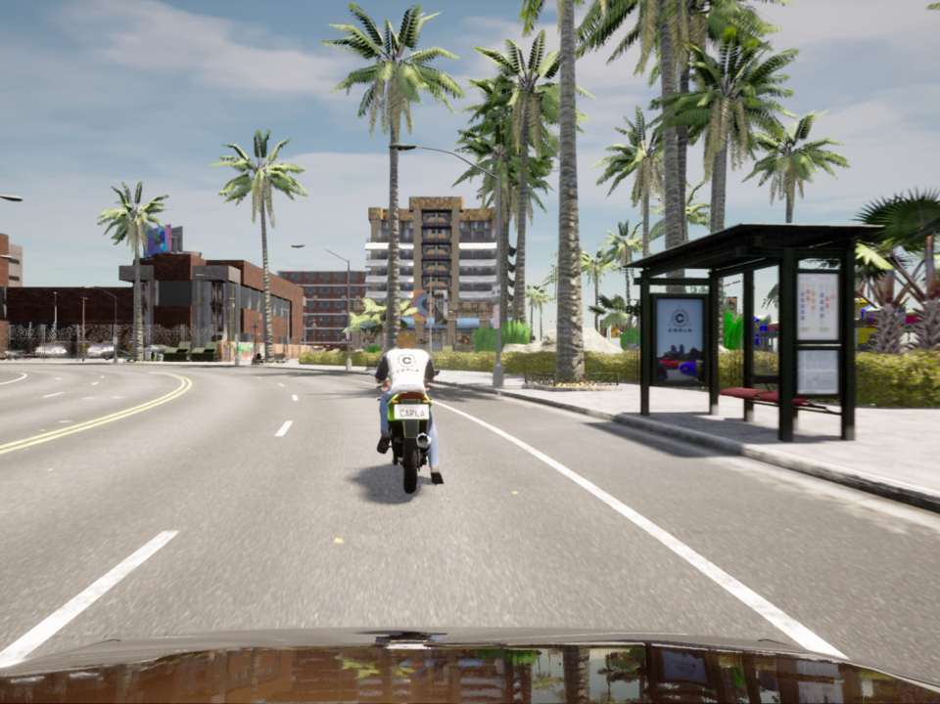
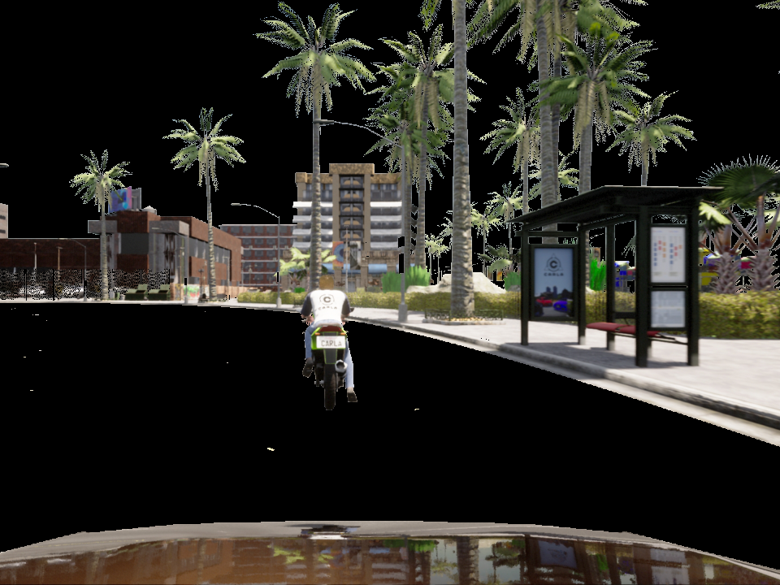
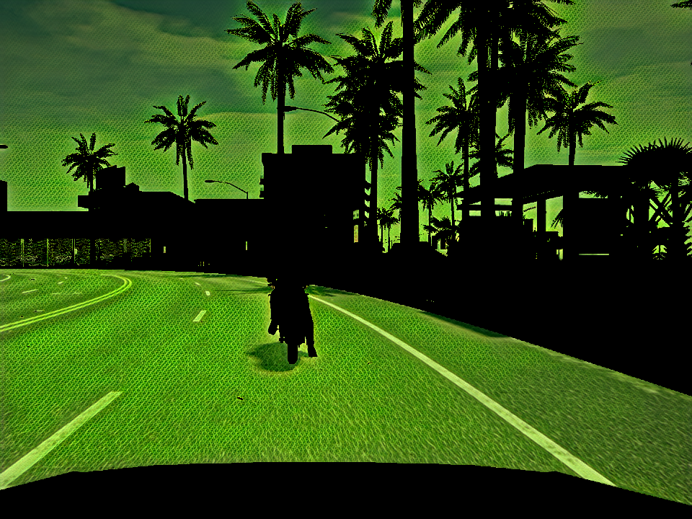
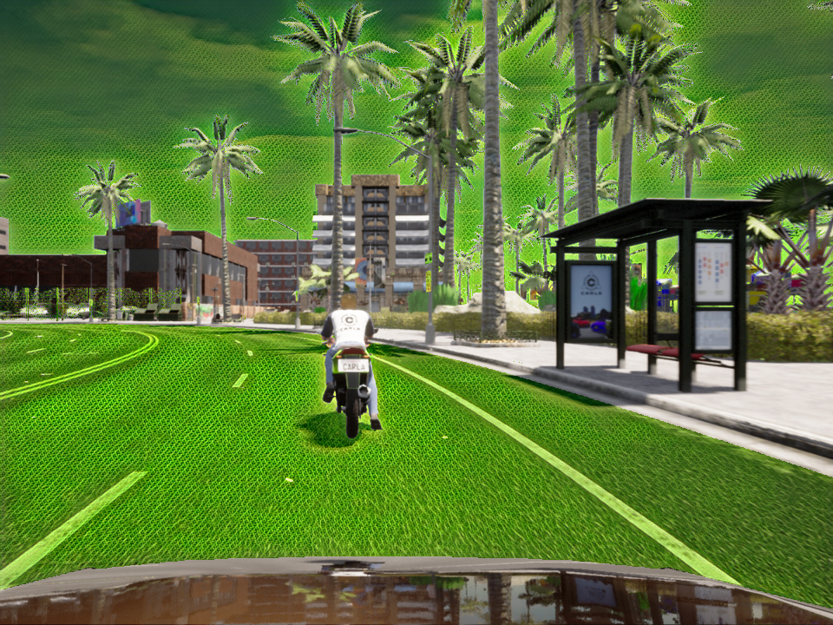
How styling model is applied
Using the binary mask, CBS extracts the background from the unstyled image and
then extracts the foreground from the styled image. Then combine them together.
Original
Background
Foreground
Result

Slide 18
Results
3

Slide 19
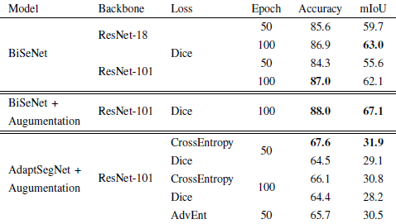
First step results
Best configuration:
Loss: CrossEntropy
Backbone: ResNet-101
Training time: 50 epochs

Slide 20
Expansion parameters
Different combinations of styles:
Single CamVid style
Single Texture style
5 CamVid styles
5 Texture styles
5 CamVid + 5 Texture styles
Single style chosen randomly for each image
Probability to stylize a class: 50%
Random subset of source dataset to match the target dataset size

Slide 21
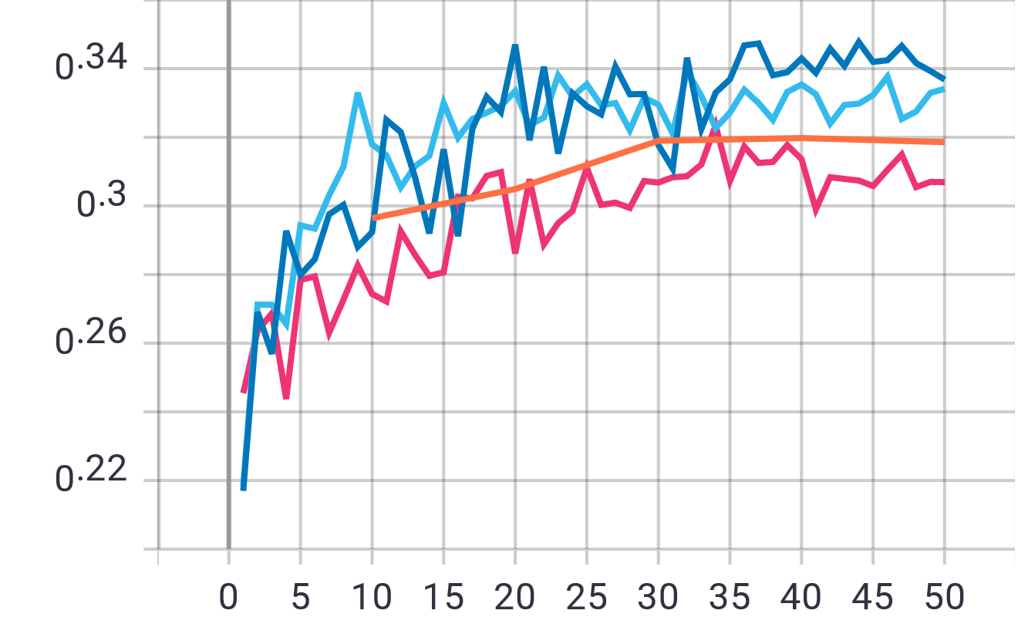
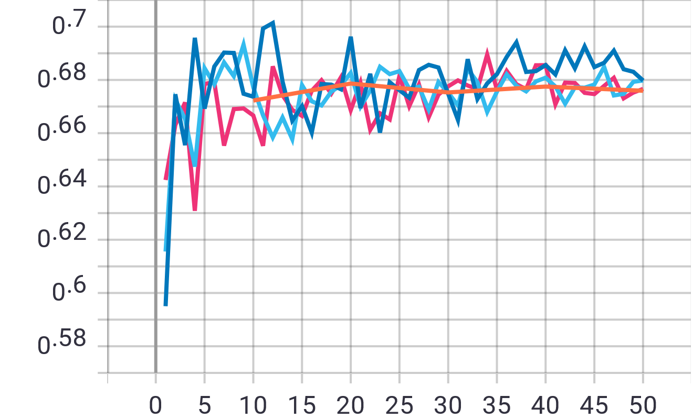
Expansion results
mIoU
pixel precision
epoch
epoch
Orange: baseline Dark Blue: CamVid styles Light Blue: CamVid + Texture styles Pink: Texture styles

Slide 22
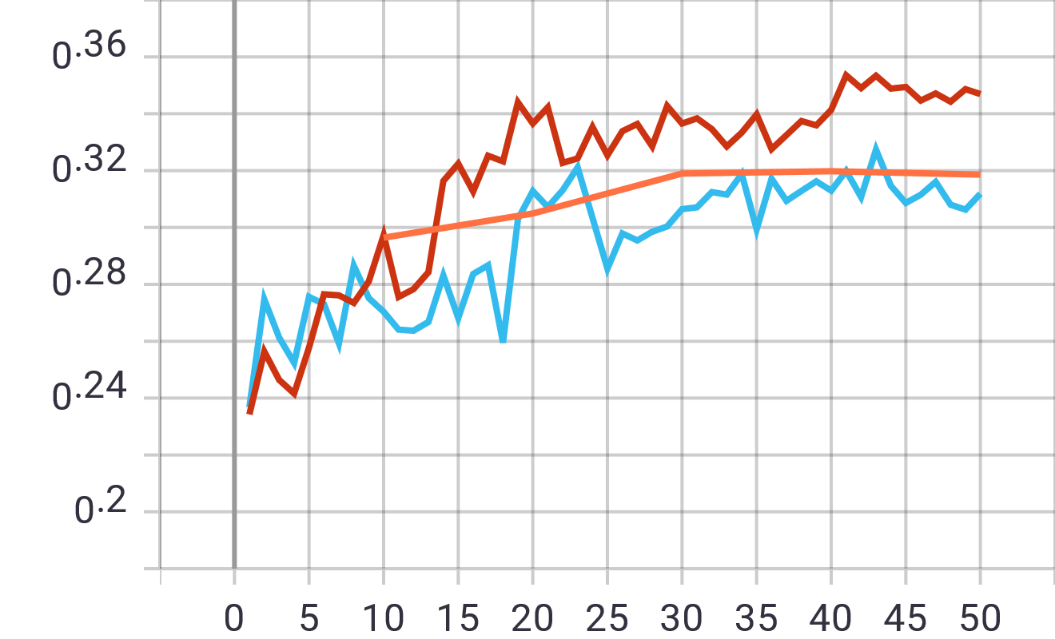
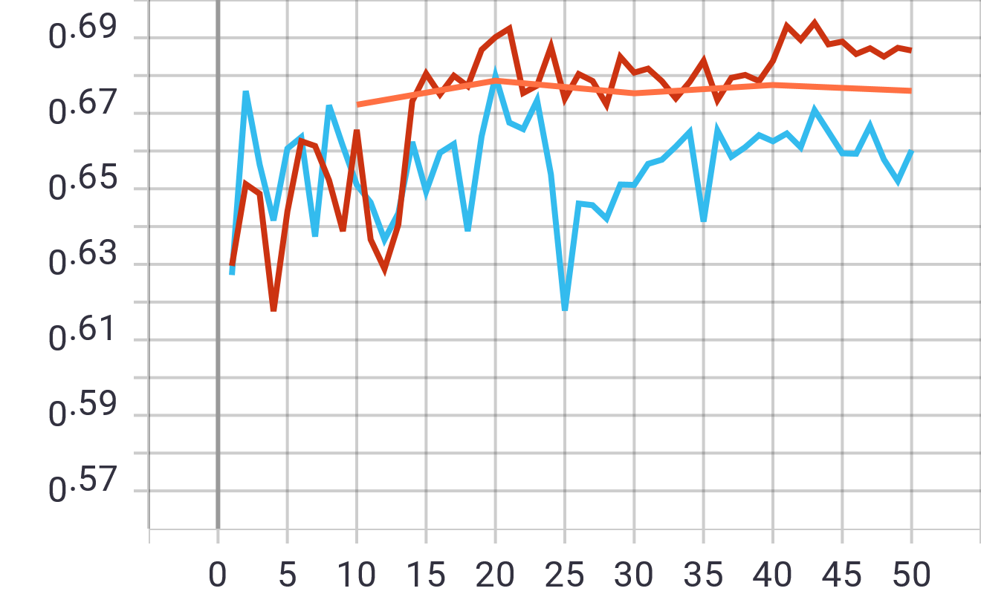
Expansion results
mIoU
pixel precision
epoch
epoch
Orange: baseline Red: CamVid5 style Light Blue: Pasta texture style
Best Result mIoU 34.7% Pixel precision 68.7%

Slide 23
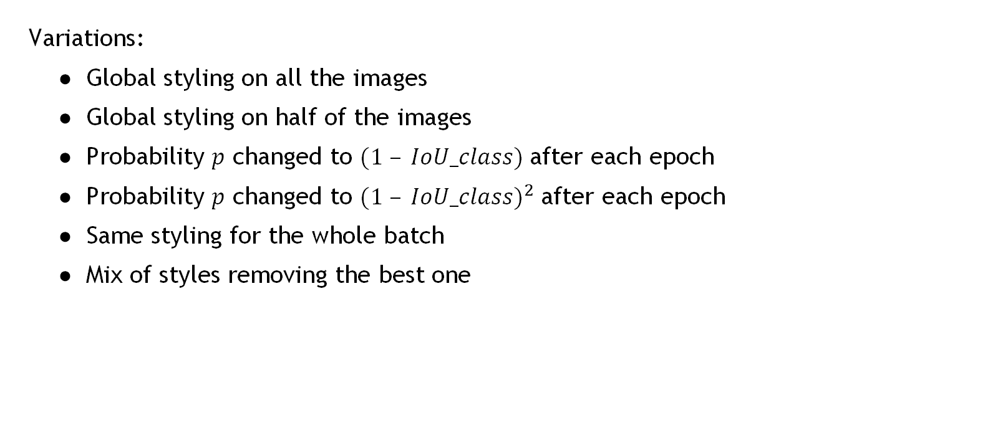
Variation study
Variations:
Global styling on all the images
Global styling on half of the images
Probability $p$ changed to $(1 – IoU_class)$after each epoch
Probability $p$ changed to ${(1 – IoU_class)}^{2}$after each epoch
Same styling for the whole batch
Mix of styles removing the best one

Slide 24
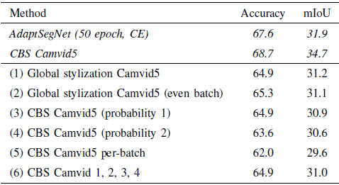
Variation results
All the runs achieved worse results
Removing the best style from the style mix worsened the performance

Slide 25
Conclusions
Interesting results with room for improvements.
Possible approaches:
Repeating the experiments using the whole source dataset at each epoch
Generate better style models
Finetune how the style models and the stylized classes are selected

Slide 26
THANKS FOR YOUR ATTENTION!

